Slide 1


Online Job Portal
Our student-led job portal aims to empower the next generation, connecting them to a diverse array of opportunities that align with their unique skills and aspirations. Through innovative technology and a personalized approach, we strive to be the premier destination for students to kickstart their careers.
Presented by :-
Harsh Yadav
Bhavneet Rana
Samarth Garg
Naveen Kumar
preencoded.png

Slide 2

Identifying the Need
Centralized p latform for job listing .
Accessibility and convince for both the job seekers
and the em ployer’ s.
Ad vanced search and filter options.
N etworking opp ortunities.
preencoded.png

Slide 3
Problem Statements
Visibility
Personalization
Engagement
How can we increase awareness of diverse job opportunities and make them easily accessible to students?
How can we tailor the job search experience to match students' unique skills, interests, and career goals?
How can we foster meaningful connections between students and employers to facilitate successful hires?
preencoded.png

Slide 4





Technology used
JAVA is used to make the backend of the project
And the backend frameworks are SPRINGBOOT
HTML CSS JAVASCRIPT
These technologies are used to make the frontend of the project
And some of the frameworks are also used
SQL (Structured Query Language ) is used to make the Database management system
preencoded.png

Slide 5

Featues :
AI-Powered Matching
Leverage machine learning algorithms to analyze student profiles and job listings, suggesting the best-fit opportunities.
Intuitive User Interface
Designed with a mobile-first approach, offering a seamless and user-friendly experience across devices.
Real-Time Analytics
Collect and analyze data to continuously improve the platform and optimize the job search process.
Secure Data Management
Implement robust data protection measures to ensure the privacy and safety of user information.
preencoded.png

Slide 6
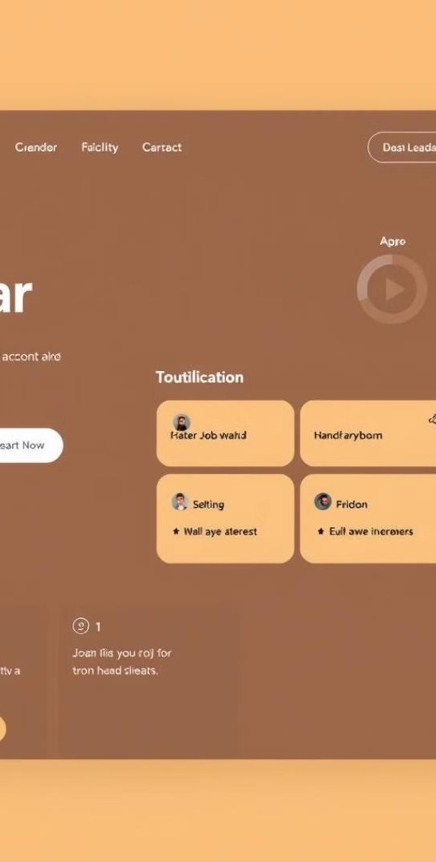




Intuitive and User-Friendly Platform Design
Effortless Job Search
Intuitive search functionality enables students to quickly find relevant openings.
Personalized Filters
Advanced filters allow students to refine their search based on location, industry, and more.
Streamlined Application
Application Status Tracking
A user-friendly application process simplifies the journey from discovery to submission.
Students can monitor the progress of their applications in real-time.
preencoded.png

Slide 7
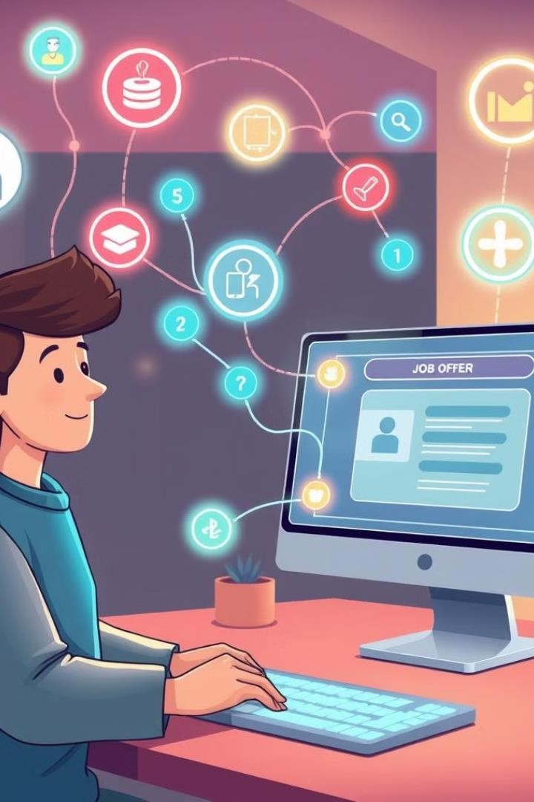

Personalized Job Recommendations: Recommendations: Tailored to Student
Student Profiles
Student Profile
Students create detailed profiles highlighting their skills, experiences,
and career aspirations.
AI-Powered Analysis
Sophisticated algorithms analyze student profiles and match them to the most suitable job listings.
Tailored Recommendations
Students receive personalized job suggestions that align with their unique qualifications and goals.

